Slide 1
Bank Churn Analysis Presentation

Slide 2
Presentation Contents
Project Background
Problem Formulation
Data Strategy
Data Cleansing and EDA
Insights from EDA
Analysis
Recommendations

Slide 3
Project Background
Banks prioritize customer retention over acquiring new ones due to higher costs associated with customer acquisition.
In the competitive banking industry, ABC Bank – our fictitious bank, is focused on reducing the rate at which customers cease transactions.
Emphasizing the quote by Katherine Burchetti, "Make a customer, not a sale," to underscore the importance of building customer relationships.
ABC Bank acknowledges that the success of their business hinges on the loyalty of existing customers.

Slide 4
Problem Formulation
How can ABC Bank analyze customer data to predict and mitigate customer churn effectively? The main objective is to analyze customer data to predict and mitigate customer churn at ABC Bank.
Further investigations will target understanding the demographics, like age group and tenure, of customers who have stopped transacting with the bank.
Implementing strategies to prevent churn contributes to retaining existing account holders and ensures the bank's long-term business stability.

Slide 5
Data Strategy
The dataset used for this project is obtained from Kaggle.
This dataset comprises 165,034 observations and includes 13 features: CustomerID, Surname, CreditScore, Geography, Gender, Age, Tenure, Balance, NumOfProducts, HasCrCard, IsActiveMember, EstimatedSalary, and Exited.
The "Exited" column, the target variable, denotes customer attrition, where 1 signifies departure and 0 indicates retention.
Utilize Logistic Regression and Random Forests to classify customers and predict churn.
Split the dataset into training and testing sets for model building and evaluation.
Compare the models to select the best-performing model.

Slide 6
Data Cleansing and EDA
The data cleaning steps done on the data are:
Dropped column – Surname column
Checked for duplicates and removed 30 observations found to have duplicated values.
Converted certain features into appropriate data types.
Renamed the ‘Geography’ column to ‘Country’
Engineered two features: Age Category and Tenure Category
Applied label encoding to two features – Gender and Country – for modeling purpose.

Slide 7
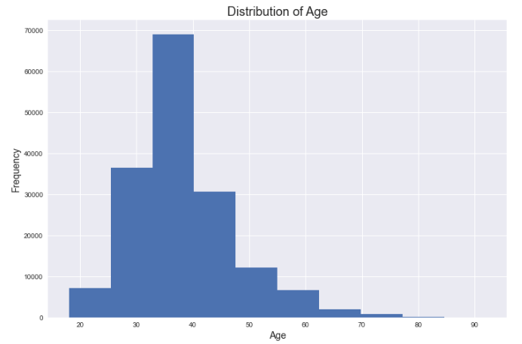
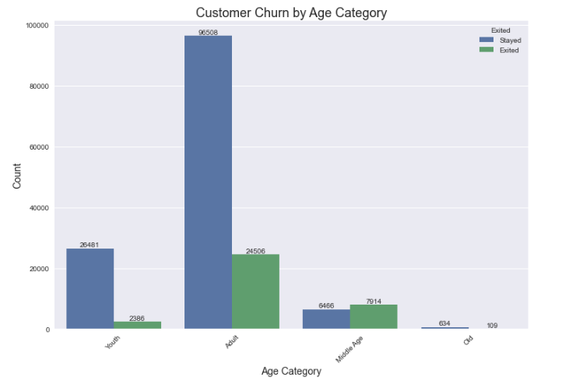
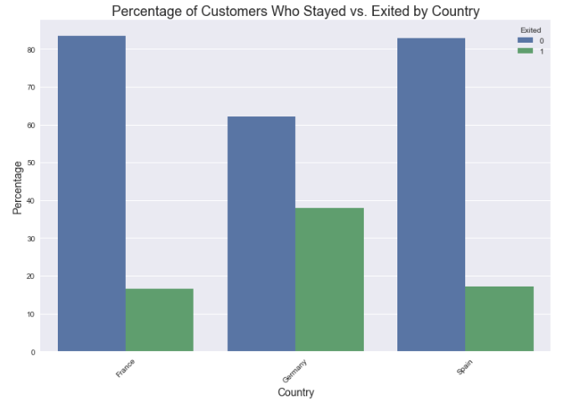
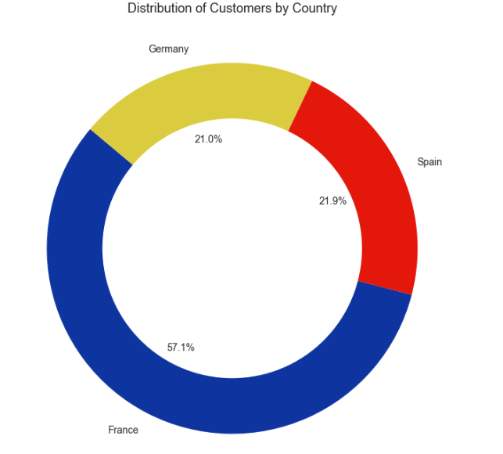

Slide 8
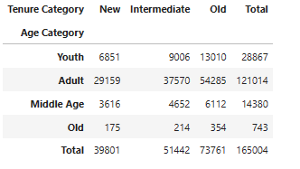
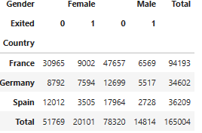
Insights from EDA
France has the highest number of customers and the highest number of customers who have stayed with the bank.
Germany has a notably higher proportion of customers who have exited (‘Exited 1’) relative to its total customer base, compared to France and Spain.
There is a significant number of customers who have stayed (130,089) with the bank compared to those who have left (34,915).
A larger proportion of female customers left the bank than male customers.
Most of the bank's clients are adults. Notably, 54,285 of them are long-standing customers, meaning they have been with the bank for 6 or more years.

Slide 9
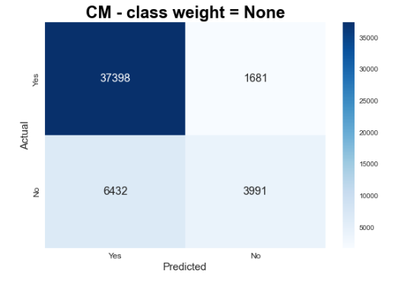


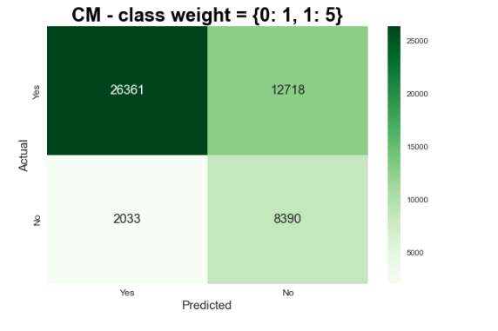


Analysis: Logistics Regression
Dataset: 165,004 observations
Split: 70% training, 30% testing
Standardization methods: Standard scaled, Robust, Min-max scaling, and Raw Data.
Chosen method: Standard scaled standardization
Optimal Model
Decision Model

Slide 10
Logistics Regression
Optimal Model Confusion Matrix Explained
True Negatives (37,398 customers): This figure represents customers who the model correctly predicted would stay with the bank.
False Positives (1,681 customers): This number refers to customers whom the model incorrectly predicted would leave, but they actually stayed.
False Negatives (6,432 customers): These are customers whom the model incorrectly predicted would stay, but they ended up leaving the bank.
True Positives (3,991 customers): This represents customers who the model correctly predicted would leave the bank, and they did.
Decision Model Confusion Matrix Explained
True Negatives (26,361 customers): The model predicted these customers would stay with the bank, and they did.
False Positives (12,718 customers): The model thought these customers were going to leave, but they stayed.
False Negatives (2,033 customers): These are the customers that the model predicted would stay, but they actually left.
True Positives (8,390 customers): The model was correct in predicting these customers would leave.

Slide 11
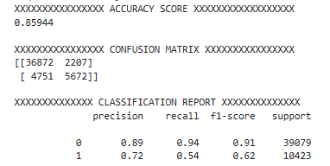
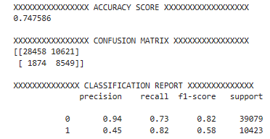
Analysis: Random Forest
Optimal Model
Dataset: 165,004 observations
Split: 70% training, 30% testing
Chosen method: Standard scaled standardization
Decision Model

Slide 12
Random Forest
Optimal Model Confusion Matrix Explained
True Negatives (36,872 customers): These customers were happy and stayed with the bank.
False Positives (2,207 customers): The model predicted customers leaving, but these customers stayed.
False Negatives (4,751 customers): These customers left when the program thought they would stay.
True Positives (5,672 customers): These customers left, just as the model predicted.
Decision Model Confusion Matrix Explained
True Negatives (28,458 customers): The model correctly predicted that these customers would stay with the bank.
False Positives (10,621 customers): The model incorrectly predicted that these customers would leave the bank, but they actually stayed.
False Negatives (1,874 customers): The model incorrectly predicted that these customers would stay, but they actually left.
True Positives (8,549 customers): The model correctly identified these customers that might leave, and they did indeed leave the bank.

Slide 13
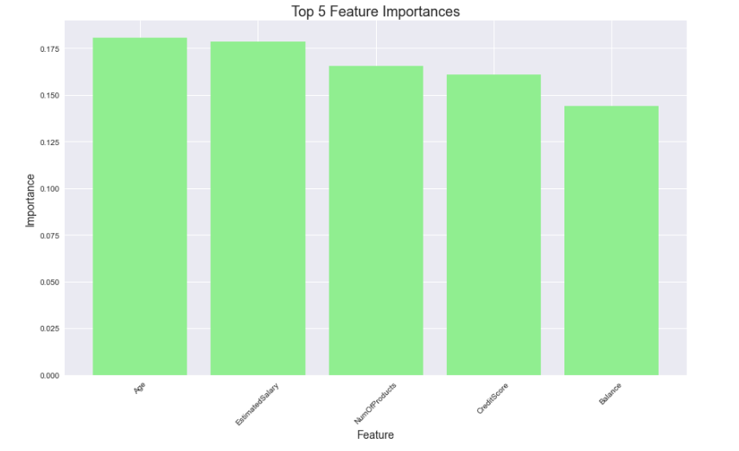
Feature Importance

Slide 14
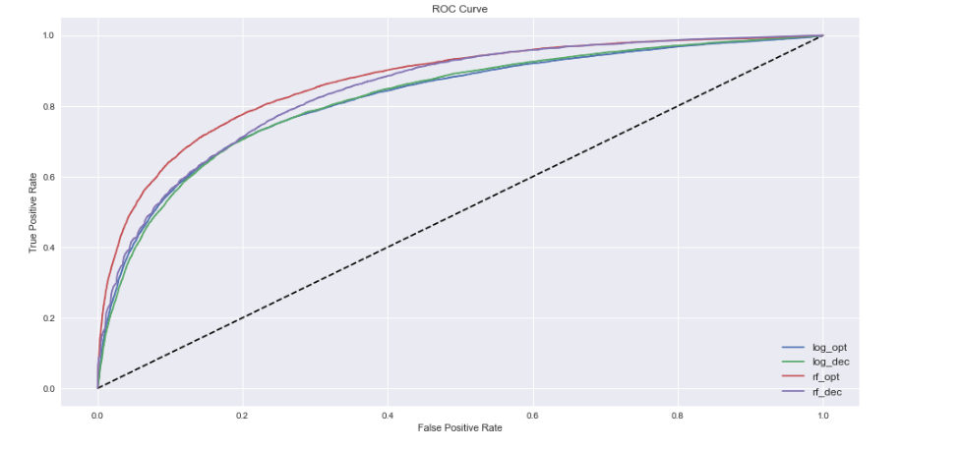
Comparison of Models
The optimal model of the random forest seems to be the best-performing model based on the ROC Curves.

Slide 15
Recommendations
Tailored retention strategies could include improved customer service, localized marketing campaigns, or product offerings suited to regional preferences, especially in Germany.
The bank might review service delivery methods or product features that may not meet the needs of female customers.
The bank could conduct satisfaction surveys among customers from time to time to understand their grievances and act on them.

Slide 16
Thank You
Presented By: Oladimeji Afolayan

